Slide 1
Game Zone MileStone 2
By Robin Phinizy

Slide 2
The Audience
The Game Zone is intended for everyone.
Games will include a simple puzzle, a platformer game, and the card game War!
The website is designed to be easy to use and the colors are very bright and vibrant.

Slide 3
Interactive Features
Buttons on the main page change the cursor image to reveal a coin to give the user a nostalgic feel of going to an arcade.

Slide 4
Layout and Design
I choose a nostalgic theme for the interface. Arcade carpet for the background and coin operated game elements for the link buttons.
It is a very loud and busy theme but I think I have toned it down with the divs using a solid background in the center of the pages.
The side nav menu system will provide an easy and familiar option for users to navigate the website and it includes a readme file.

Slide 5
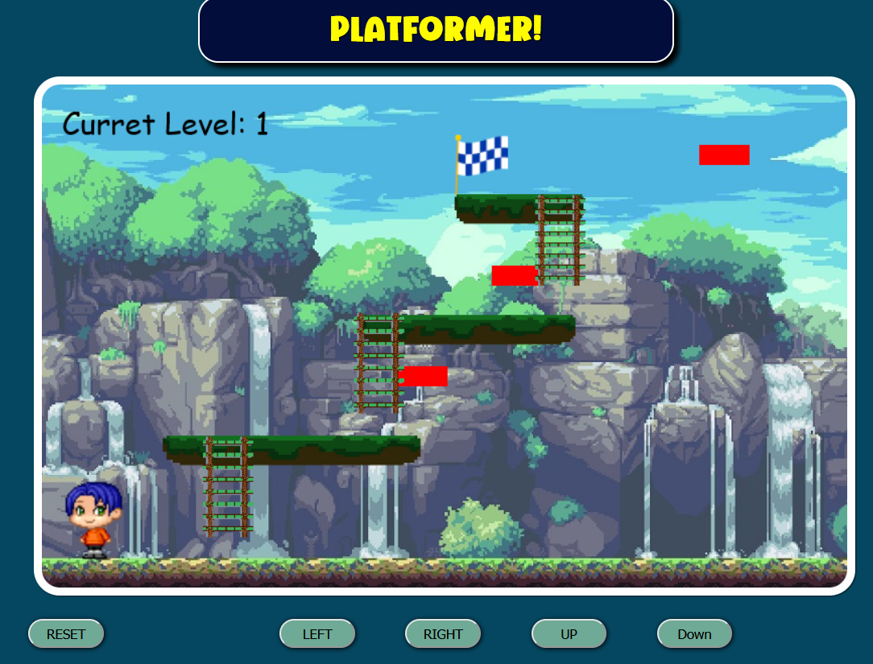
Game #1 Platformer
Javascript

Slide 6
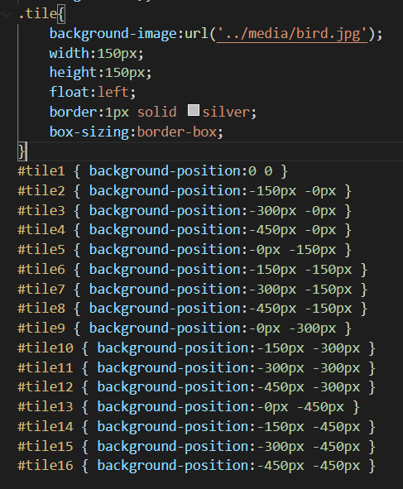
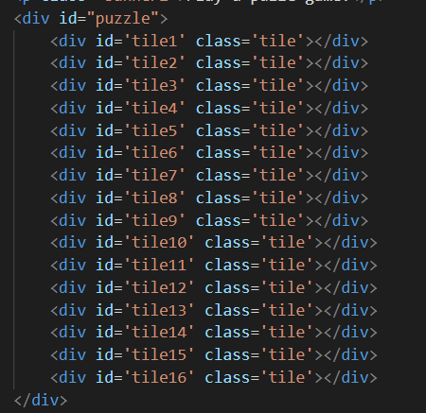
Game #2 Puzzle Game
JQUERY

Slide 7
Problems and Future Ideas
Organization and Time Management.
Platformer game red blocks.
May have to rethink Game #3.

